Slide 1
Final project ds
By: Nicholas Nagy

Slide 2
What is the dataset?

Slide 3
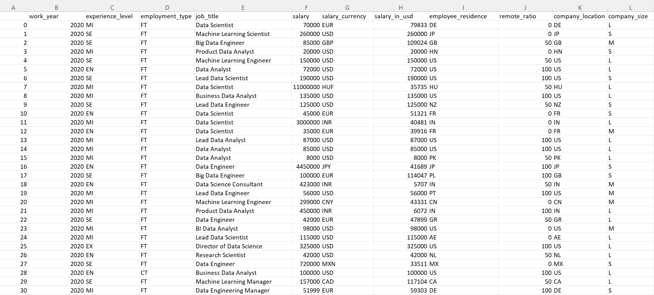
The Dataset

Slide 4
Question #1
If you were planning on going into the data science field, what is the estimated salary?

Slide 5
Who is this question directed to?

Slide 6

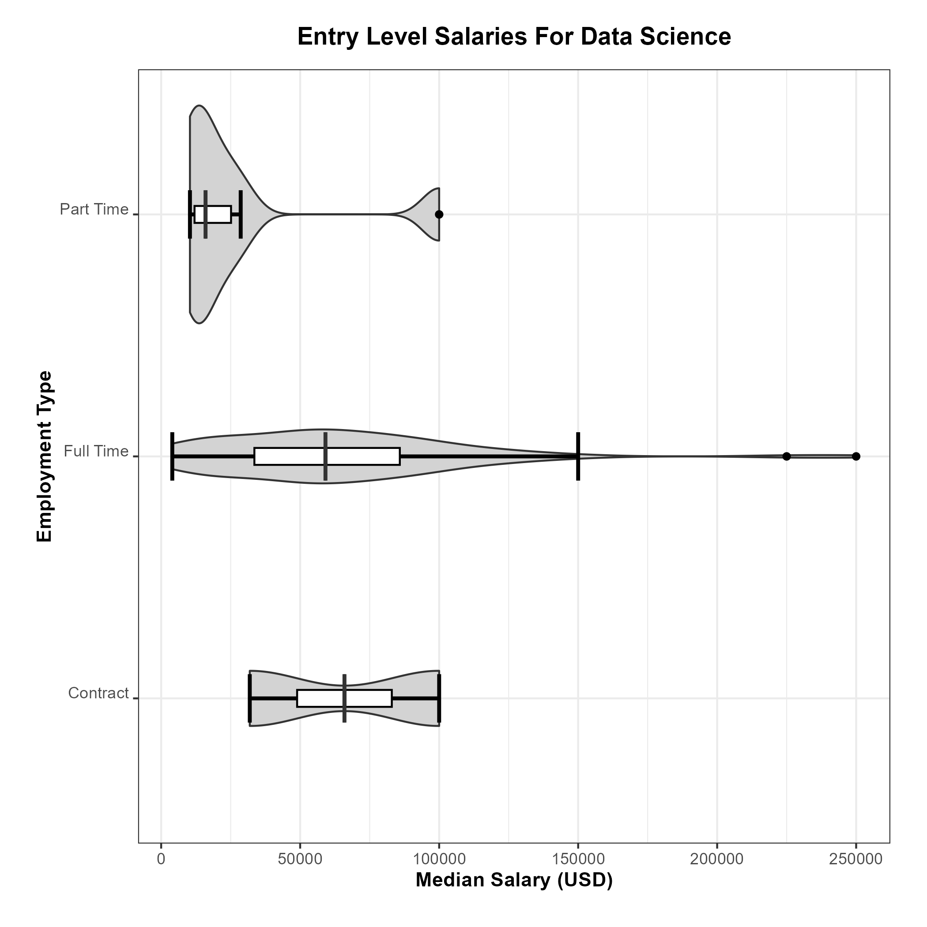

The first part of the plot

Slide 7
What about the future?
Where can we go from here?

Slide 8
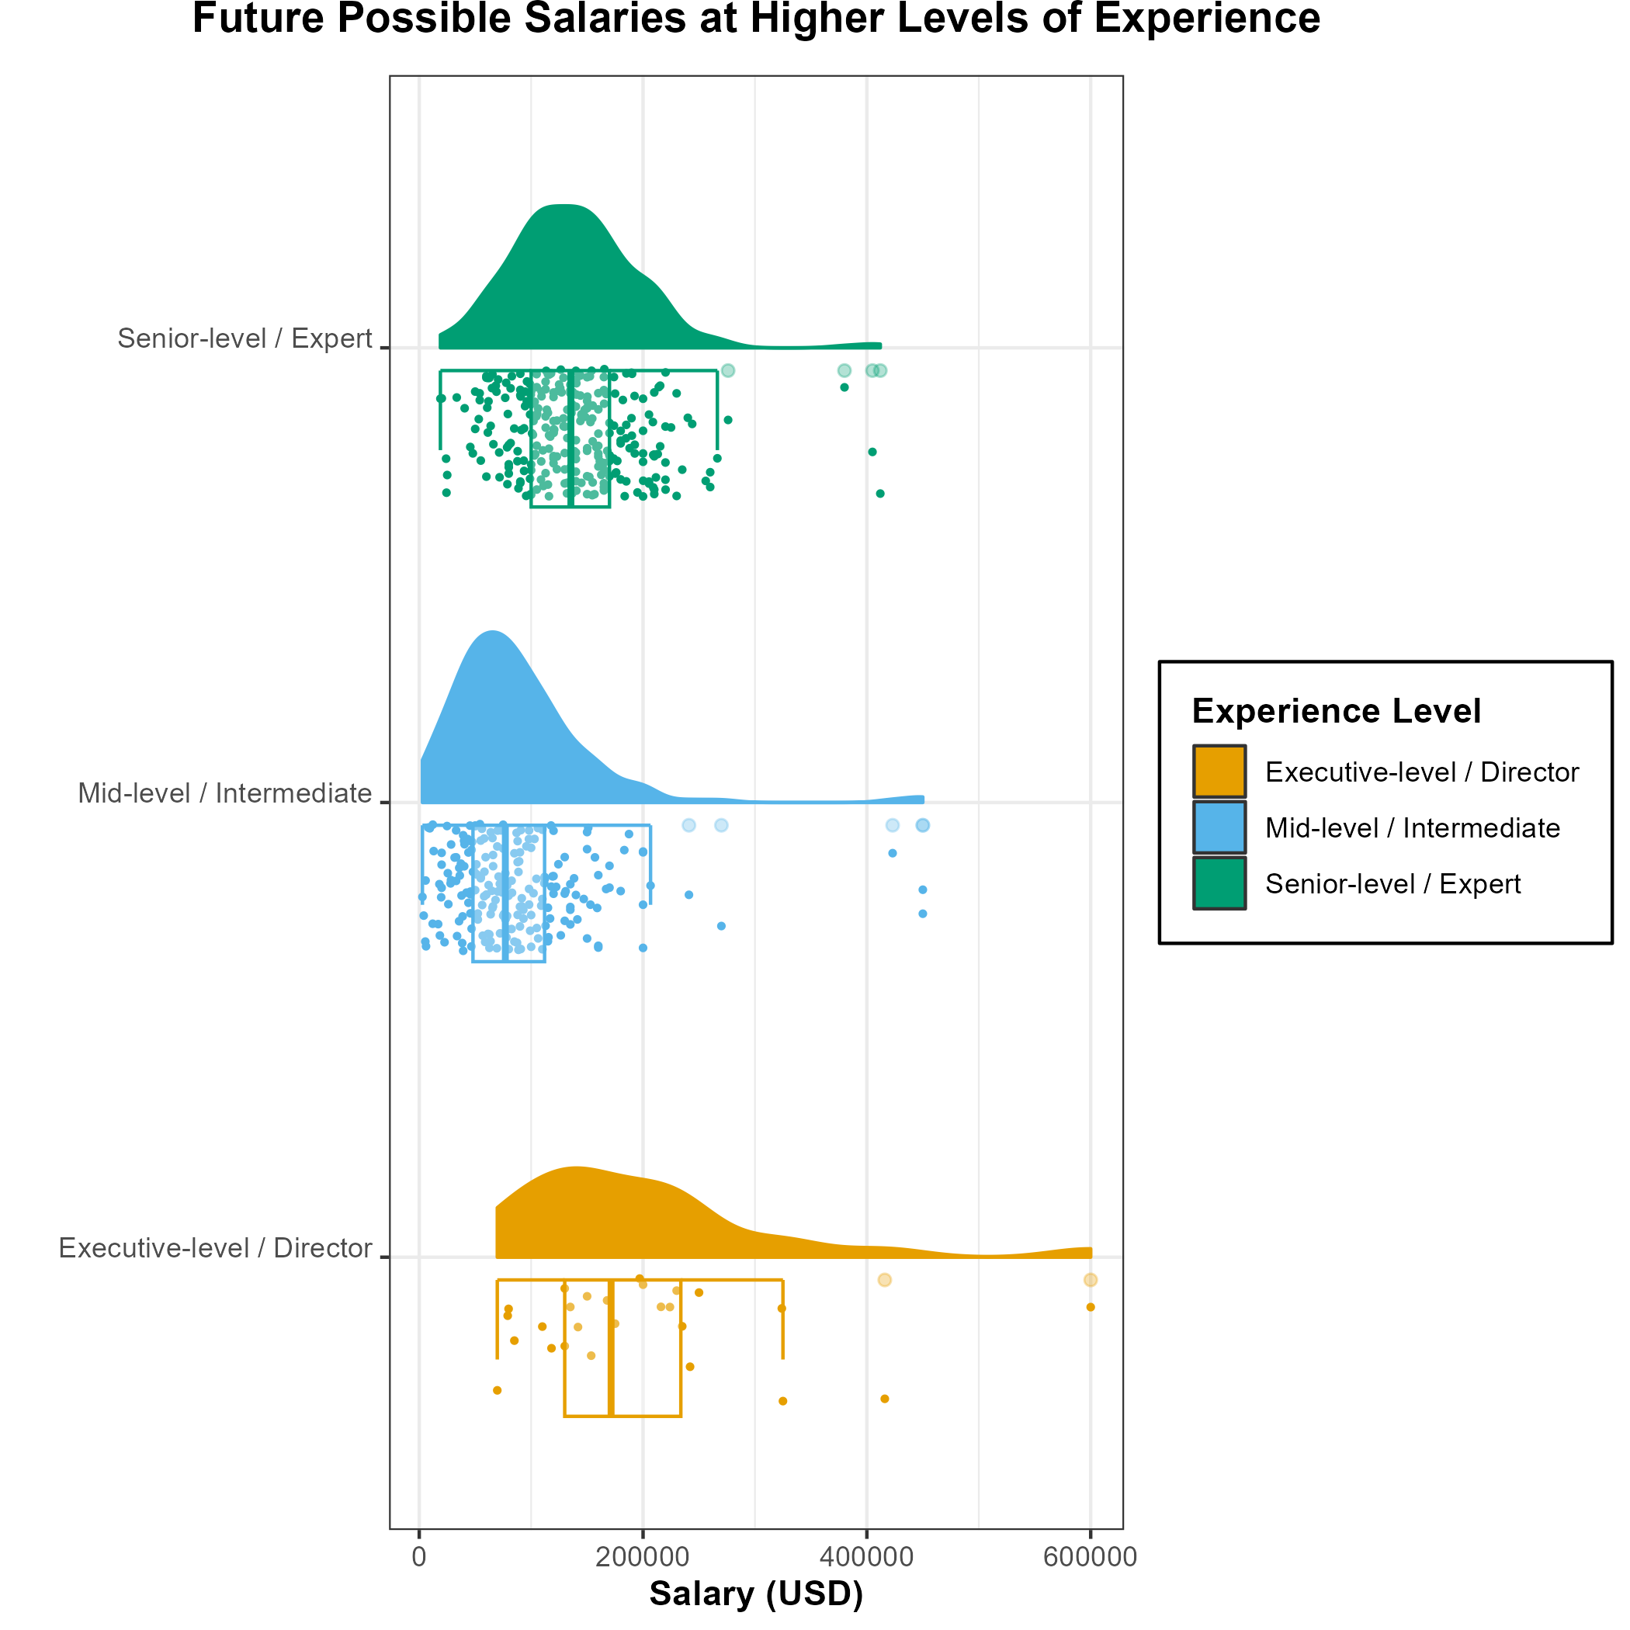
Future promotions

Slide 9
Question #2
Does a larger company pay more? What company size would be best to look for a better salary?

Slide 10
Who is this question directed to?

Slide 11
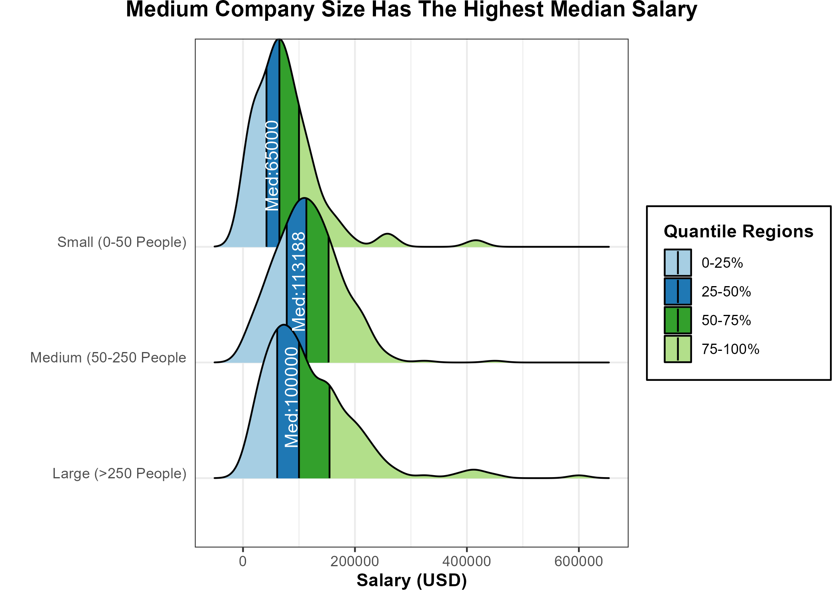
The Plot
What was the objective?
Was it achieved?
How about accessibility?

Slide 12
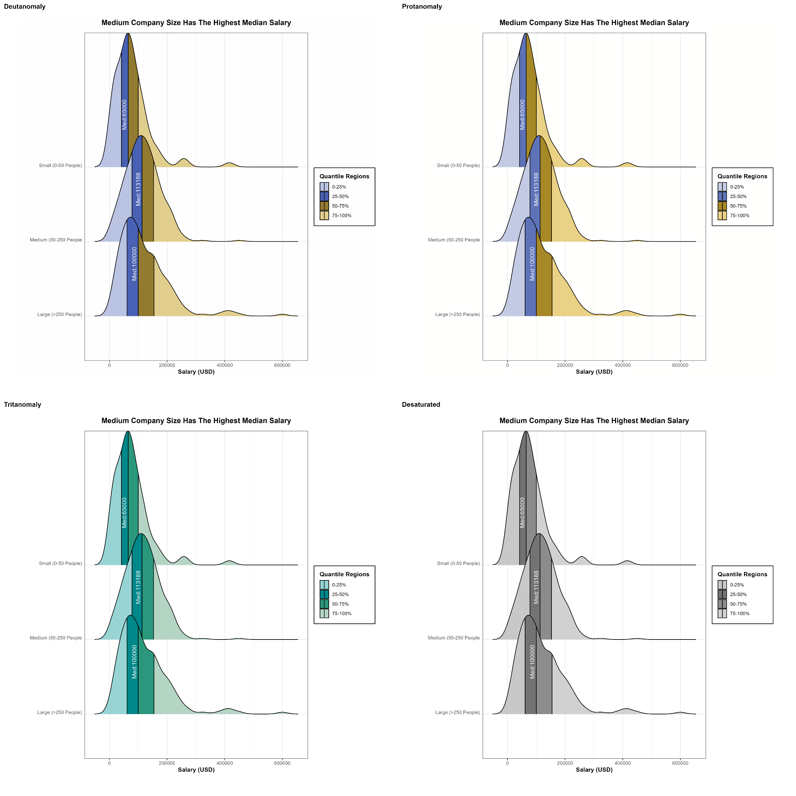
Colour blind?
No Problem

Slide 13
Question #3
How does location correlate with someone's salary? Does remote work correlate with it also?

Slide 14
Who is this question directed to?

Slide 15
Perfect lets plot
Wait overplotting

Slide 16
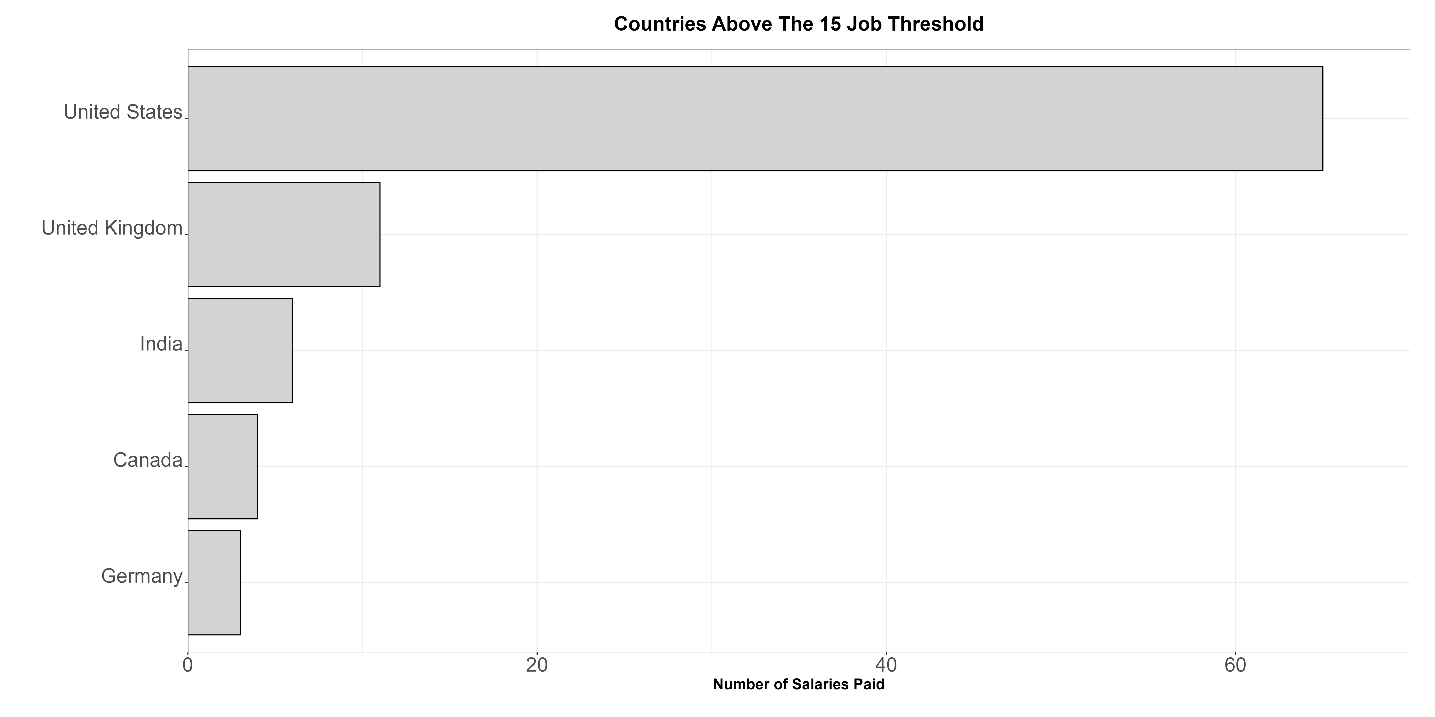
How TO Start?
The process needs to be streamlined.

Slide 17
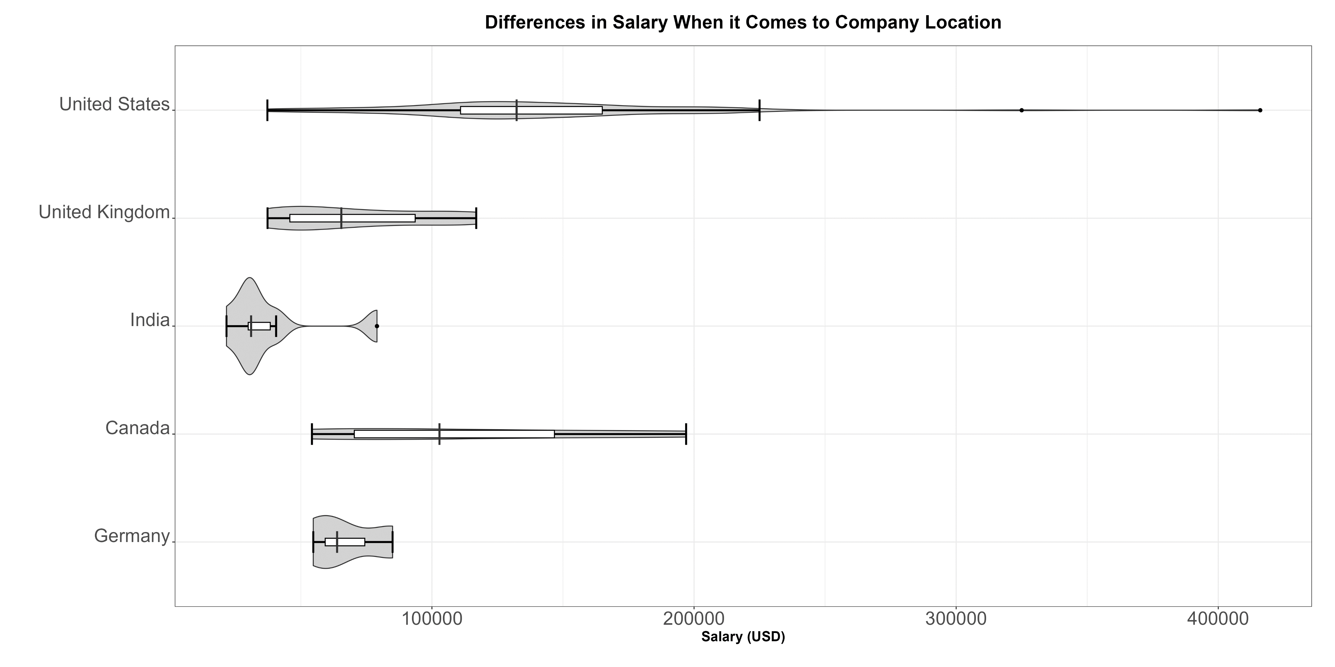
Effective transitioning

Slide 18
what about remote work?

Slide 19
What story was told?
Was this type of plot splitting effective?

Slide 20
Personal improvements
Is there any improvements I would make?

Slide 21
Thank you
Any questions?

